Slide 1
MINIMIZING POWER CONSUMPTION IN VIDEO SERVERS BY THE COMBINED USE OF SOLID-STATE DISKS AND MULTI-SPEED DISKS
PANCHAMI A MOHAN
Class no: 44 S7 BTECH CSE

Slide 2
CONTENTS
MINIMIZING POWER CONSUMPTION IN VIDEO SERVERS BY THE COMBINED USE OF SSDs AND MULTI-SPEED DISKS
INTRODUCTION
BASIC IDEA
SYSTEM MODEL
SSD STORAGE ALLOCATION
SSD BANDWIDTH ALLOCATION
COPING WITH DISK SPEED CHANGES
BANDWIDTH ALLOCATION ALGORITHM
COMPARISON WITH EXISTING MODELS
CONCLUSION

Slide 3
INTRODUCTION
MINIMIZING POWER CONSUMPTION IN VIDEO SERVERS BY THE COMBINED USE OF SSDs AND MULTI-SPEED DISKS
Growing demand for video data
Servers typically use RAID
40% power for Storage Systems
50% power for Cooling systems
Reducing disk spin speed
Multispeed Disks

Slide 4
MULTI-SPEED DISKS
MINIMIZING POWER CONSUMPTION IN VIDEO SERVERS BY THE COMBINED USE OF SSDs AND MULTI-SPEED DISKS
Proposed by Gurumurthi
Speed-changing scheme called dynamic RPM
Reduction in energy used when server workloads are intense
Hibernator reduces disk speeds as often as possible
Real-Time data retrieval not guaranteed

Slide 5
SOLID STATE DRIVES
MINIMIZING POWER CONSUMPTION IN VIDEO SERVERS BY THE COMBINED USE OF SSDs AND MULTI-SPEED DISKS
Uses IC assemblies as memory to store data persistently
No moving mechanical components
More resistant to physical shock
Run silently
Have quicker access time
Lower latency

Slide 6
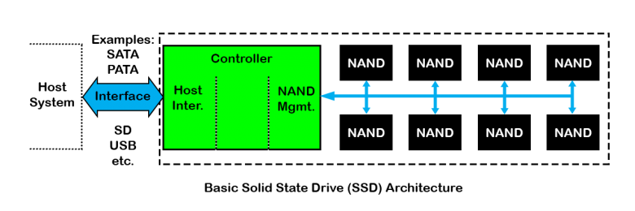
BASIC SSD ARCHITECTURE
MINIMIZING POWER CONSUMPTION IN VIDEO SERVERS BY THE COMBINED USE OF SSDs AND MULTI-SPEED DISKS
Courtesy:https://www.cactus-tech.com/assets/images/9

Slide 7
USE OF SSD IN SERVERS
MINIMIZING POWER CONSUMPTION IN VIDEO SERVERS BY THE COMBINED USE OF SSDs AND MULTI-SPEED DISKS
Low power consumption
Low latency when reading data
Good throughput for large random reads
Good performance for sequential writes
Limitation
High cost of SSDs
Solution
SSD used for caching data only

Slide 8
BASIC IDEA
MINIMIZING POWER CONSUMPTION IN VIDEO SERVERS BY THE COMBINED USE OF SSDs AND MULTI-SPEED DISKS
I/O requests served by SSD cache
Disk bandwidth utilization is reduced
Decreases power consumed
Effective SSD BW utilization is essential
Effect of allocation of SSD on disk bandwidth
Power consumption variation with SSD responses

Slide 9
SYSTEM MODEL
MINIMIZING POWER CONSUMPTION IN VIDEO SERVERS BY THE COMBINED USE OF SSDs AND MULTI-SPEED DISKS
Request
Data in SSD ?
Served by SSD
Served by Disk
YES
NO
Round based Scheduling
Time divided into rounds , Tr
Each client served once in a round
Server allocates BW wrt bitrate, bi

Slide 10
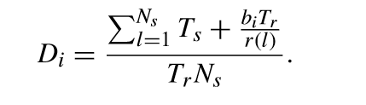
SYSTEM MODEL (contd…)
MINIMIZING POWER CONSUMPTION IN VIDEO SERVERS BY THE COMBINED USE OF SSDs AND MULTI-SPEED DISKS
DBWU = Total service time / Round length
DBWU : less than or equal to 1
Assumptions
Constant Seek Time , Ts
Zero Rotational Delay

Slide 11
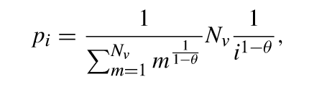

SSD STORAGE ALLOCATION
MINIMIZING POWER CONSUMPTION IN VIDEO SERVERS BY THE COMBINED USE OF SSDs AND MULTI-SPEED DISKS
Arrival of client requests - Poisson distribution
Access probability - Zipf distribution
Gi - expected disk BW utilization reduction

Slide 12

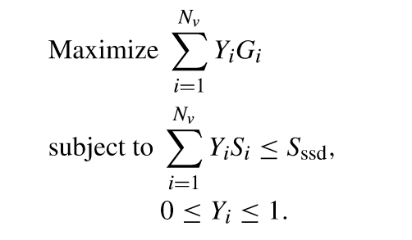
SSD STORAGE ALLOCATION(contd..)
MINIMIZING POWER CONSUMPTION IN VIDEO SERVERS BY THE COMBINED USE OF SSDs AND MULTI-SPEED DISKS
Yi proportion of video i is cached ( 0 <= Yi <= 1 )
Cache video ﬁles to maximize the disk BW reduction
Total SSD Allocation problem – ( knapsack problem)

Slide 13
SSD BANDWIDTH ALLOCATION
MINIMIZING POWER CONSUMPTION IN VIDEO SERVERS BY THE COMBINED USE OF SSDs AND MULTI-SPEED DISKS
Power Phases of Disk
Seek
Idle
Active
Seek phase consists of:
Speedup step
Coast step
Slowdown step
Settle step

Slide 14
SSD BANDWIDTH ALLOCATION(contd..)
MINIMIZING POWER CONSUMPTION IN VIDEO SERVERS BY THE COMBINED USE OF SSDs AND MULTI-SPEED DISKS
Seek consumes most energy
Reducing seek operations critical
Process low bit-rate requests first from SSD
Exact amount of data, biTr needs to be read

Slide 15
SSD BANDWIDTH ALLOCATION(contd..)
MINIMIZING POWER CONSUMPTION IN VIDEO SERVERS BY THE COMBINED USE OF SSDs AND MULTI-SPEED DISKS
Rk,m - request for video cached in SSD
Request combinations in SSD
Xk,m – whether mth element of Ak are served by SSD
Xk,m : 0 or 1

Slide 16
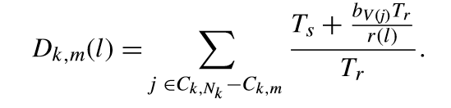
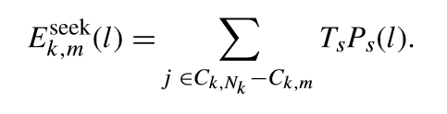
SSD BANDWIDTH ALLOCATION(contd..)
MINIMIZING POWER CONSUMPTION IN VIDEO SERVERS BY THE COMBINED USE OF SSDs AND MULTI-SPEED DISKS
Disk BW utilization in each level l, when Xk,m =1
Energy required in seek phase

Slide 17
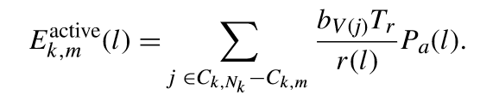
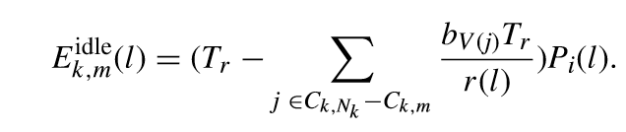
SSD BANDWIDTH ALLOCATION(contd..)
MINIMIZING POWER CONSUMPTION IN VIDEO SERVERS BY THE COMBINED USE OF SSDs AND MULTI-SPEED DISKS
Energy required in active phase
Energy required in idle phase

Slide 18
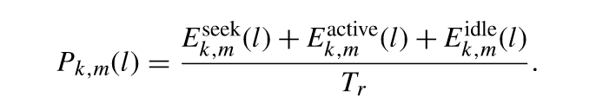
SSD BANDWIDTH ALLOCATION(contd..)
MINIMIZING POWER CONSUMPTION IN VIDEO SERVERS BY THE COMBINED USE OF SSDs AND MULTI-SPEED DISKS
Power consumption by disk k when the speed level is l and Xk,m =1
Sum of seek, active and idle power

Slide 19
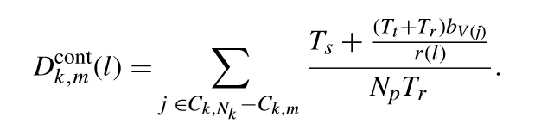
COPING WITH DISK SPEED CHANGES
MINIMIZING POWER CONSUMPTION IN VIDEO SERVERS BY THE COMBINED USE OF SSDs AND MULTI-SPEED DISKS
Considerable amount of time for speed change
Cannot handle disk requests – causes jitter
Prefetching necessary

Slide 20
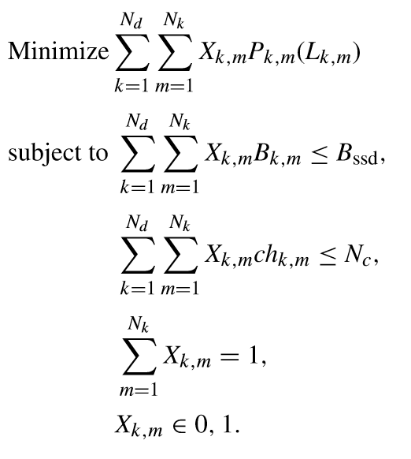
PROBLEM FORMULATION
MINIMIZING POWER CONSUMPTION IN VIDEO SERVERS BY THE COMBINED USE OF SSDs AND MULTI-SPEED DISKS
C1 : Total BW to serve requests from the SSD
less than SSD BW
C2 : Number of speed changes less than Nc

Slide 21
BANDWIDTH ALLOCATION ALGORITHM
MINIMIZING POWER CONSUMPTION IN VIDEO SERVERS BY THE COMBINED USE OF SSDs AND MULTI-SPEED DISKS
QFk,m = ratio of power difference to bandwidth difference
QSk,m = power difference
Xk,m initialised to 0

Slide 22
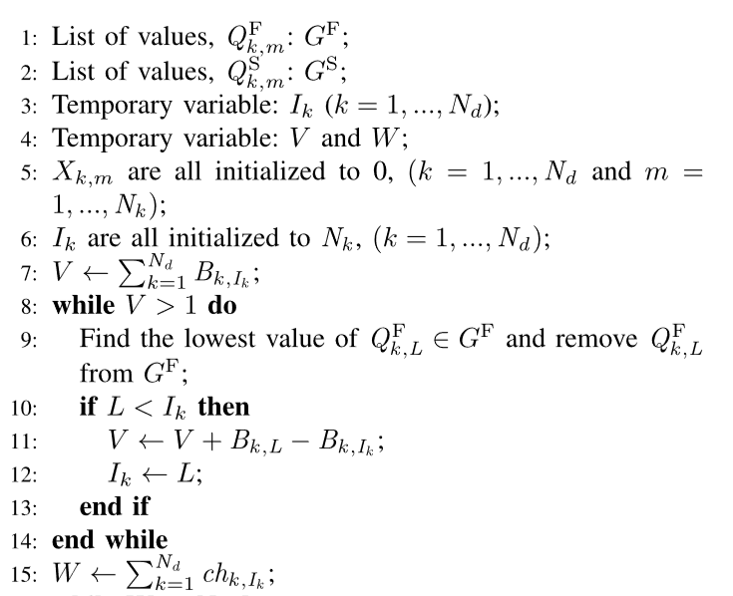
BANDWIDTH ALLOCATION ALGORITHM (contd…)
MINIMIZING POWER CONSUMPTION IN VIDEO SERVERS BY THE COMBINED USE OF SSDs AND MULTI-SPEED DISKS
Courtesy:https://ieeexplore.ieee.org/document/8314694

Slide 23
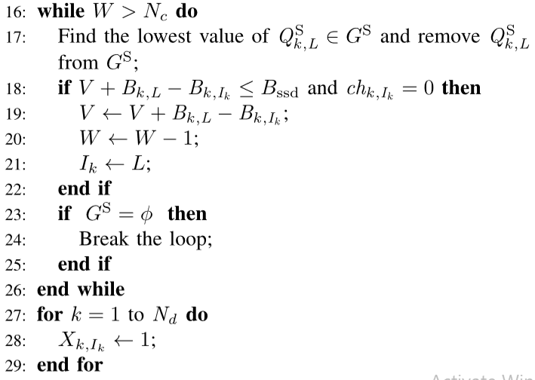
BANDWIDTH ALLOCATION ALGORITHM (contd…)
MINIMIZING POWER CONSUMPTION IN VIDEO SERVERS BY THE COMBINED USE OF SSDs AND MULTI-SPEED DISKS
Courtesy:https://ieeexplore.ieee.org/document/8314695

Slide 24
BANDWIDTH ALLOCATION ALGORITHM (contd…)
MINIMIZING POWER CONSUMPTION IN VIDEO SERVERS BY THE COMBINED USE OF SSDs AND MULTI-SPEED DISKS
Runs when new client is accepted for video service
Accommodate new workload changes immediately
Frequent speed changes in the long term when running BAA
Speed changes are allowed only periodically

Slide 25
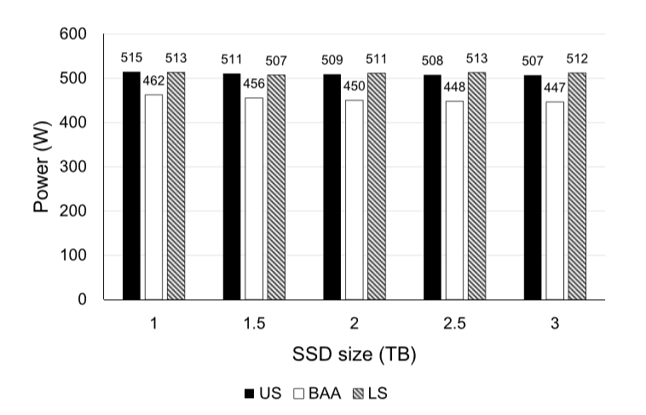
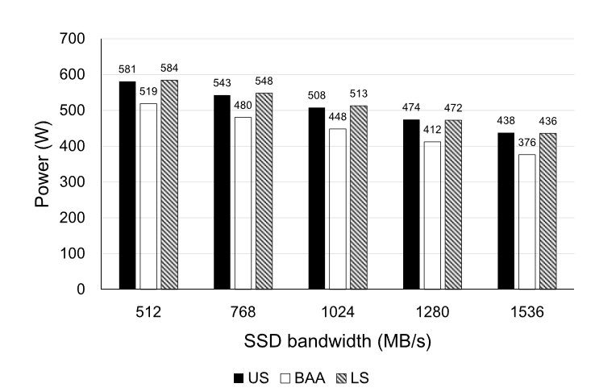
COMPARISON WITH EXISTING MODELS
MINIMIZING POWER CONSUMPTION IN VIDEO SERVERS BY THE COMBINED USE OF SSDs AND MULTI-SPEED DISKS
EFFECT OF SSD SIZE
EFFECT OF SSD BANDWIDTH
Courtesy:https://ieeexplore.ieee.org/document/8314698
Courtesy:https://ieeexplore.ieee.org/document/8314698

Slide 26
CONCLUSION
MINIMIZING POWER CONSUMPTION IN VIDEO SERVERS BY THE COMBINED USE OF SSDs AND MULTI-SPEED DISKS
Power management scheme for a video server
SSD used as cache for a disk array with multi-speed disks
Variation of power consumption with the amount of SSD bandwidth
Formulated optimization problem for minimizing disk power consumption
Limiting number of speed changes and considering SSD BW
Effective use of BW to support the high request rates for video ﬁles

Slide 27
REFERENCES
MINIMIZING POWER CONSUMPTION IN VIDEO SERVERS BY THE COMBINED USE OF SSDs AND MULTI-SPEED DISKS
1. 37 Mind Blowing YouTube Facts, Figures and Statistics2018. Accessed:
Apr. 26, 2018. [Online]. Available: https://fortunelords.com/youtubestatistics/
2. M. Dayarathna, Y. Wen, and R. Fan, ``Data center energy consumption
modeling: A survey,'' IEEE Commun. Surveys Tuts., vol. 18, no. 1,
pp. 732794, 1st Quart., 2016.
3. Z. Li, K. Greenan, A. Leung, and E. Zadok, ``Power consumption in
enterprise-scale backup storage systems,'' in Proc. USENIX Conf. File
Storage Technol., Feb. 2012, pp. 17.
4. M. Khatib and Z. Bandic, ``PCAP: Performance-aware power capping for
the disk drive in the cloud,'' in Proc. USENIX Conf. File Storage Technol.,
Feb. 2016, pp. 227240.
5. Q. Zhu, Z. Chen, L. Tan, Y. Zhou, K. Keeton, and J. Wilkes, ``Hibernator:
Helping disk arrays sleep through the winter,'' ACM Operat. Syst. Rev.,
vol. 39, no. 5, pp. 177190, 2005.

Slide 28
REFERENCES
MINIMIZING POWER CONSUMPTION IN VIDEO SERVERS BY THE COMBINED USE OF SSDs AND MULTI-SPEED DISKS
6. Q. Zhu and Y. Zhou, ``Power-aware storage cache management,'' IEEE Trans. Comput., vol. 54, no. 5, pp. 587602, May 2005.
7. S. Gurumurthi, ``Power management of enterprise storage systems,''Ph.D. dissertation, Dept. Comput. Sci. Eng., Pennsylvania State Univ.,State College, PA, USA, 2005
8. S. Gurumurthi, A. Sivasubramaniam, M. Kandemir, and H. Franke,``Reducing disk power consumption in servers with DRPM,'' Computer,vol. 36, no. 12, pp. 5966, Dec. 2003.
9. IntelliPower. Accessed: Feb. 8, 2018. [Online]. Available:
https://support.wdc.com/knowledgebase/answer.aspx?id=3665
10. Automaid Technical Brief. Accessed: May 8, 2018. [Online]. Available:
https://www.nexsan.com/wp-content/assets/white-papers/AutoMAIDTechnical-
Brief-White-Paper.pdf

Slide 29
THANK YOU
MINIMIZING POWER CONSUMPTION IN VIDEO SERVERS BY THE COMBINED USE OF SSDs AND MULTI-SPEED DISKS

